Slide 1
Olist Store Analysis
Domain: E-Commerce
Project Group Members
1) MISS. KEERTHANA KUNDAPUR
2) MISS. PRIYA RAMESH SHINDE
3) MR. SAURABH SUBHASH NAVALE
4) MR. MANOJ LM
PROJECT MENTOR: SHUBHAM SIR

Slide 2




TOOLS USED:
EXCEL
MYSQL
TABLEAU
POWER BI

Slide 3
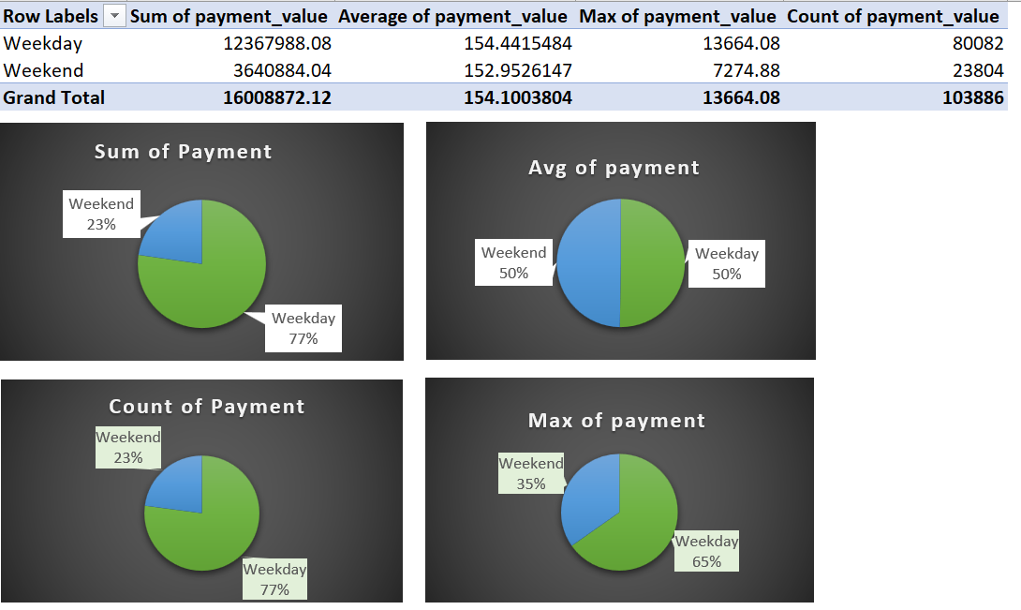
KPI 1:Weekday Vs Weekend (order_purchase_timestamp) Payment Statistics

Slide 4
Conclusion
In Weekday the Sum of Payment Value is 77% and in Weekend its only 23%, So here we can say that Weekday has more Sum of payment Value than Weekend may be because people head out more on weekends. Which means they are offline. Based on this logic, a business site will get more hits during the weekdays.
When we consider Weekday: Monday has the highest payment value and for Weekend: Sunday has the highest payment Value and here in both Weekday as well as in the Weekend the payment was done more through credit card.
Here the highest sold product name is Beleza saude and highest product sold City and State are sao paulo and SP.

Slide 5
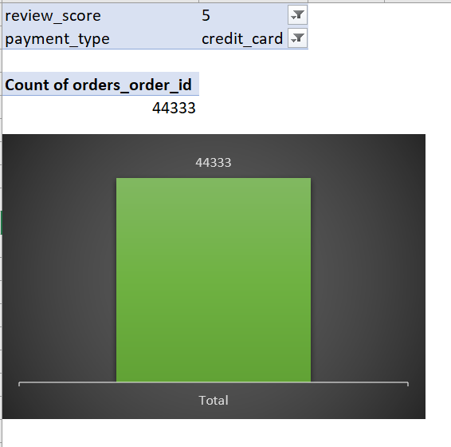
KPI 2: Number of Orders with review score 5 and payment type as credit card.

Slide 6
Conclusion
When we consider the other payment types, the Number of orders with the review score 5 for credit card is more and less for debit card.
Similarly when we consider other review scores, the Number of orders with payment type as credit card the review score 5 has the maximum number of orders where as review score 2 has the least number of orders.
Here we concluded that the product Category name Beleza saude in the sao Paulo city and state SP is doing more transaction for payment type as credit card and review score 5.

Slide 7
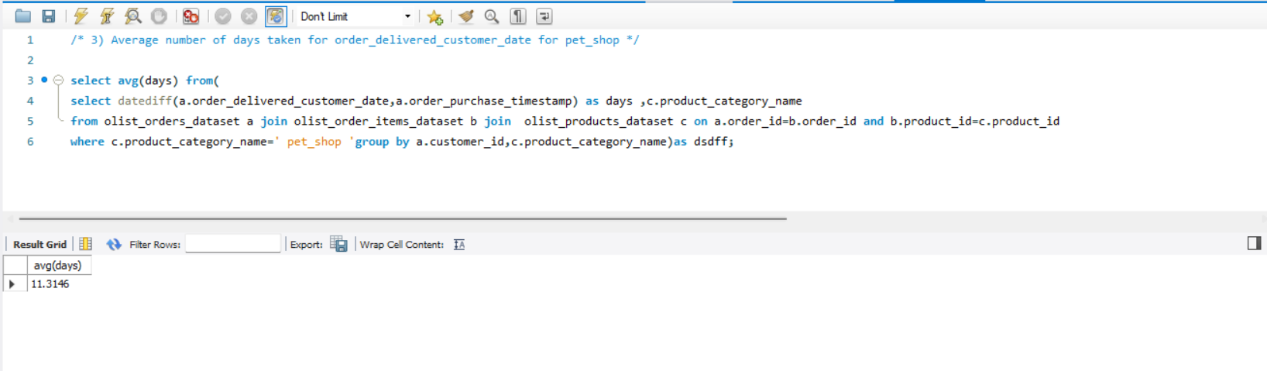
KPI 3: Average number of days taken for order_delivered_customer_date for pet_shop

Slide 8
Conclusion
Here we conclude that the product category name called moveis_escritorio taking highest average number of days and artes_e_artesanato taking less average number of days to deliver order to the customer.
When we consider the payment type, the average number of days to deliver order to the customer is more through boleto where as payment type credit card is taking less number of days.
When we consider city the average number of days to deliver order to the customer is more in novo brasil and less in iomere.
Similarly when we consider state the average number of days to deliver order to the customer is more in RR and less in SP.
So from this we concluded that our target should be more on the product, city as well as the state which taking more Average Number of days to deliver order to the customer.

Slide 9
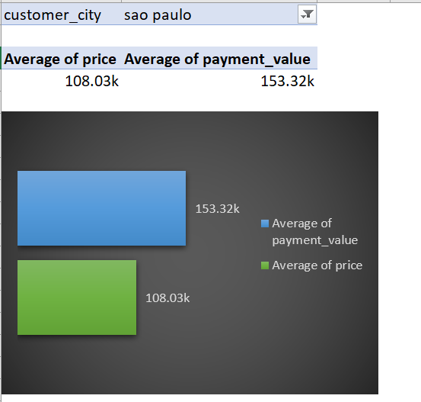
KPI 4: Average price and payment values from customers of sao paulo city

Slide 10
Conclusion
The Product Category name pcs has the highest price and payment value where as casa_conforto_2 has the less price and payment value.
The highest average price and payment values from customers of sao paulo city is done through credit card and boleto.
When we consider other cities, pianco has highest price and payment value and when we consider states, BA has the highest price and payment value.

Slide 11
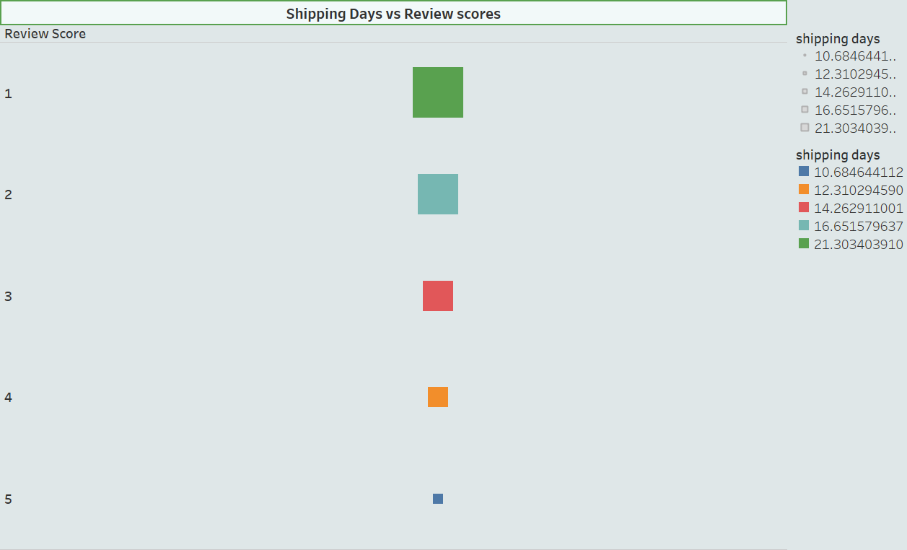
KPI 5: Relationship between shipping days (order_delivered_customer_date - order_purchase_timestamp) Vs review scores.

Slide 12
Conclusion
Here we got 1 review score for both highest as well as for lowest number of shipping days so we can conclude that there is no relationship between Review Score and Shipping Days.
Similarly we got 5 review score for both highest as well as lowest number of shipping days.

Slide 13
Thank You!!

